Slide 1
Review how the Supportive Housing System collectively addresses ending homelessness in Santa Clara County
Discuss the distinct role of coordinated entry within the Supportive Housing System
Share your perspective on the successes and gaps within the Supportive Housing System

Slide 2
Today’s Supportive Housing System in Santa Clara County and the Role of Coordinated Entry within it
and

Slide 3
The 2020-2025 Community Plan to End Homelessness serves as our newest roadmap for addressing our homelessness crisis. It was built upon input from more than 8,000 community members, people with lived experience of homelessness, service providers, and advocates, and grounded in evidence-based practices and lessons learned over the past five years.

Slide 4
Community Plan to End Homelessness, 2020-2025
Address the root causes of homelessness through system and policy change
Strategy 1
Expand homelessness prevention and housing programs to meet the need
Strategy 2
Improve quality of life for unsheltered individuals and create healthy neighborhoods for all
Strategy 3

Slide 5
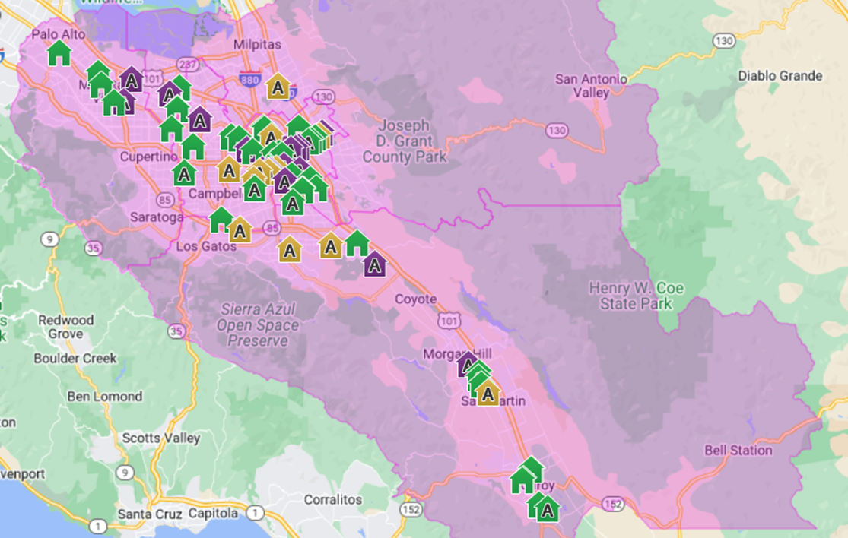
Rapid Growth in Supportive Housing Production

Slide 6
Growth in Housing Capacity (Units), 2015 to 2022

Slide 7
Progress toward our 5-year Goals
Notes:
2 years or 40% into the plan

Slide 8
Lessons Learned
LESSONS LEARNED THROUGH 2022
Collective Impact
Common Agenda
Shared Measurement Systems
Mutually Reinforcing Activities
Continuous Communication
Backbone Support Organizations
Leadership
Partnership
Start small and build up to systems change

Slide 9
Housing inflow and Housing Placements
This progress on the Community Plan to End Homelessness 2020-2025 goals is helping us significantly narrow the gap between the number of people becoming homeless, known as “inflow,” and the number of people exiting homelessness, or “housing placements,” but we still have work to do to turn the tide on ending homelessness.

Slide 10
Even with our Progress, Homelessness is Prevalent in SCC
Point-in-time Census, 2007-2022

Slide 11
More people become homeless than our system can house
Monthly Housing Placements vs. Homeless Inflow, August 2021 through July 2022

Slide 12
Does Coordinated Entry solve this?
No. Coordinated Entry does not …
… create more housing supply
… guarantee access to housing
… place people on waiting lists for Section 8 housing, low-income affordable housing complexes, or private housing complexes
… guarantee eligibility for housing or programs (additional paperwork will be needed if a household is matched to a participating program)

Slide 13
Then Why do we have Coordinated Entry?
Currently, there are not enough housing units/vouchers for all people experiencing homelessness in Santa Clara County.
Coordinated entry…
… prioritizes the most vulnerable households for the housing resources that are available now.
… provides information about people whose needs are not met to enable us to advocate for more resources.

Slide 14
Coordinated Entry is more than the VI-SPDAT
Access to all CoC resources no matter where or how people present
Single, centralized point of access to emergency shelter beds
Housing Problem Solving support
Consistent decision making to connect people to the best fit housing interventions
Prioritizes people for supportive housing aligned with our community’s values

Slide 15
Supportive Housing System

Slide 16
Homelessness Prevention System Spotlight: A Strategic and Coordinated Service Model
Targets support to households most at risk of homelessness
Provides flexible financial assistance, legal support, case management and other services
Prevents participating households from becoming unhoused
Network of 20 community partners
Notes:
[JESSICA]
[NOTES FOR REFERENCE] Homelessness prevention strategies have long held potential for reducing homelessness at a lower-cost and with much less suffering than waiting to assist a family or individual who’s been pushed onto the streets. And with more of our neighbors being pushed into homelessness than ever before, a focus on prevention has never been more important. In SCC, for every two homeless individuals we connect to housing, three more individuals are experiencing homelessness for the very first time.
To this end, the HPS:
Is administered through a unique partnership with 20 community-serving nonprofits – with Sacred Heart Community Service as the lead – and is funded by more than a dozen different government, corporate and philanthropic partners;
Prioritizes those at the highest-risk of falling into homelessness, utilizing a standardized pre-screening interview and questionnaire to help evaluate each household’s risk and the amount and type of assistance they need to stay housed;
Provides critical assistance in the form of flexible financial assistance, case management, streamlined access to eviction defense legal services, and resources to low-income households at imminent risk of becoming homeless; and
Prevents participating households from entering the homelessness system
Source: https://destinationhomesv.org/homelessness-prevention/

Slide 17
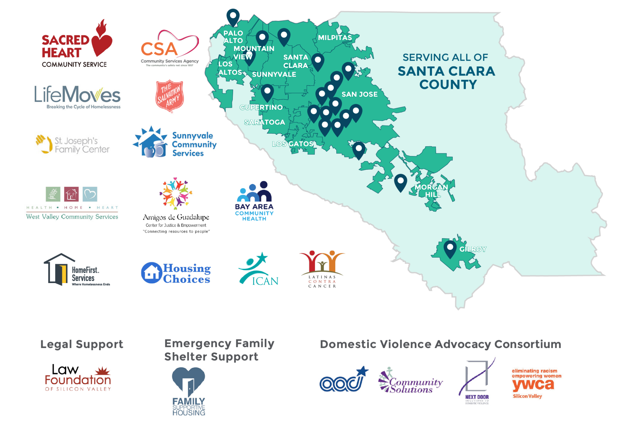
System Partners
Notes:
Initially launched as a pilot coordinated by the County of Santa Clara Office of Supportive Housing, Destination: Home, and Sacred Heart Community Service
Historically anchored by the Emergency Assistance Network, a group of seven nonprofit organizations based in different areas of the county that has long been the community’s primary provider of homelessness prevention services
Expanded to deploy $46 million through the Emergency Rental Assistance program in response to COVID-19 with the help of over 70 different non-profit and community partners
[JESSICA]
[NOTES FOR REFERENCE] Under the leadership and coordination of Destination: Home, the Homelessness Prevention System pilot re-envisioned the community’s approach to preventing homelessness. With an initial investment of $4.2 million dollars from public and private sources, this 27-month pilot program streamlined access to essential resources for families in crisis, targeted resources to those most at risk of homelessness, and provided a rich source of information about the nature of housing crises in Santa Clara County and which tools are most effective at permanently stabilizing housing for at-risk families.
HPS Services were initially provided by the Emergency Assistance Network, comprised of Community Services Agency of Mountain View and Los Altos, LifeMoves, Sacred Heart Community Service, Salvation Army, St. Joseph’s Family Center, Sunnyvale Community Services, and West Valley Community Services.
The HPS expanded in response to the pandemic. With the help of Sacred Heart Community Service and over 70 different non-profit and community partners, Destination: Home raised and deployed $46 million in public and private funding to support low-income community members at risk of becoming homeless due to economic impacts of the pandemic.
[Emphasize it is a different program so the philosophy and policies are v different. ]
Sources:
https://osh.sccgov.org/sites/g/files/exjcpb671/files/EndingHomelessness2017.pdf
https://osh.sccgov.org/sites/g/files/exjcpb671/files/EndingHomelessness%282019-2020%29.pdf
https://homebase.box.com/s/06kg8kr89640vlnpyqfkd5k3k8bryuh5
https://destinationhomesv.org/documents/2021/03/homelessness-prevention-system.pdf/

Slide 18
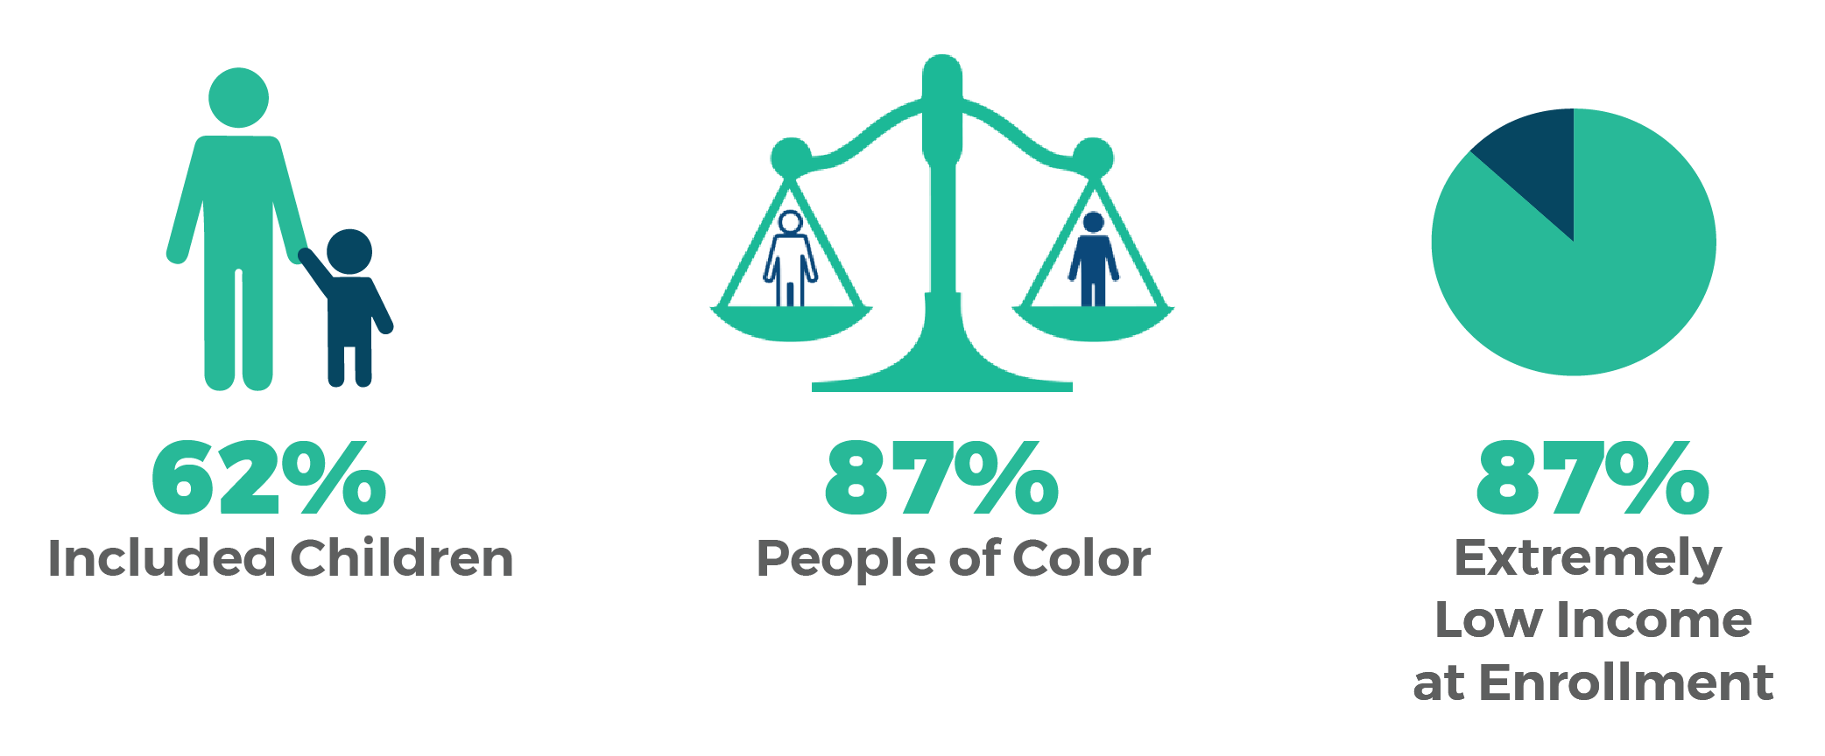
Who do we serve?
18

Slide 19
Homelessness Prevention Assessment Tool (HPAT)
Purpose:
Evidence, lived-experience informed triage tool that assesses vulnerability
Origins in the VI-SPDAT
Intentionality
No provider specialty required
Extension of CES
Standardized Assessment
Match to best resources
Prioritizing vulnerability
Simplify the process
Questions about:
Household composition
Current financial situation
Current health
Housing history and other factors
City affiliation
Foster care
Incarceration
Mobility
Health insurance

Slide 20
Resources and Services
Financial Assistance
Legal Support & Eviction Defense
Case Management Services
Benefits Application Assistance
Other Services
Notes:
Financial Assistance - Immediate cash assistance that can be used towards rent, utilities and other basic expenses
Other - Help accessing services & resources provided by other partners (i.e. employment assistance, landlord mediation, financial coaching)
The homelessness prevention program focuses on households (HH) at risk of homelessness in the community and provides critical homelessness prevention resources and services to them.
The program provides financial assistance related to housing: rent move-in costs rental arrears
Housing specialist assistance to the clients including: housing search location referral landlord mediation/dispute resolution information regarding tenant rights

Slide 21
Homelessness Prevention System Impact
Notes:
[REFERENCE NOTES] Since the system was launched in 2017, the HPS has helped prevent homelessness for thousands of our most vulnerable residents – demonstrating the enormous potential impact that prevention strategies can have in the efforts to end homelessness in SCC.
D:H is also partnering with the University of Notre Dame’s Lab for Economic Opportunity, who is conducting a comprehensive independent review of the effectiveness of the HPS.
Key takeaways of that study:
Decreased use of homelessness services
Decreased shelter entry
Decreased use of services persists over time
Decreased impact of emergency financial assistance after COVID-19
Emergency financial assistance decreases use of homelessness services over time, thus preventing a return to homelessness rather than just delaying it.
We estimate that for every $1 spent on program participants, $2-$3 in benefits are created.
Source: https://destinationhomesv.org/homelessness-prevention/system-metrics/

Slide 22
Housing Initiatives that further support the prioritization Committee’s Guiding values

Slide 23
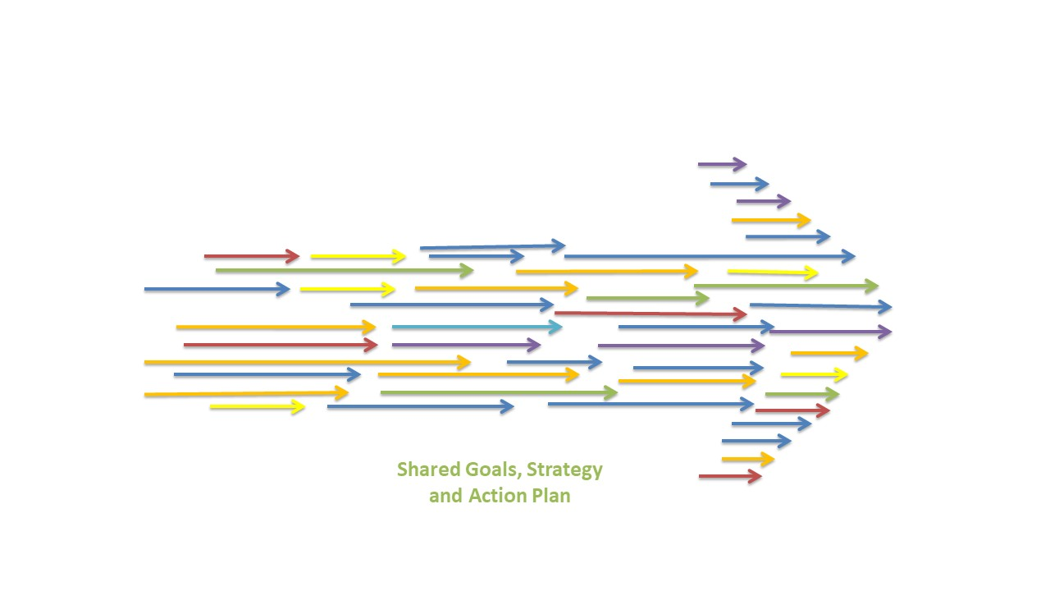
What are Housing Initiatives all about?
Housing Initiatives focus on a subpopulation or approach, implemented like a campaign. We coordinate efforts and evaluate progress across many different program areas, and work with stakeholders to achieve Collective Impact.
Notes:
Focus on a particular subpopulation or approach
Often involves a campaign or other time-limited effort to increase access to housing across our system
Coordination of efforts/tracking progress across many different program areas
Homelessness prevention
Outreach and emergency response
Interim housing/RRH/PSH
Housing development
Lots of work with stakeholders
OSH teams, Cities, Other County Depts, Destination: Home, Housing Authority, CBOs

Slide 24
Ending Veteran Homelessness
New funding to house veterans
Financial incentives for landlords
New partnerships to expand pool of housing
Increased coordination to match veterans to housing
Functional Zero
# of veterans housed has exceeded # of homeless veterans seeking assistance
Model for housing other vulnerable populations

Slide 25
Youth and Young Adult Homelessness
Youth and Young Adult Leadership
Youth Homelessness Demonstration Program
Youth Action Board
Coordinated Community Plan
$10.4 million in HUD CoC funding over 2 years
Flexibility in CoC regulations
5 CBOs implementing programs
Youth → <= 17 yo
Young Adult → 18-24 yo
Notes:
Lead by Youth and Young Adults
$10.4M award for 2 years ($5.2M annually), renewable after initial 2 years through CoC process
Must have Coordinated Community Plan approved by HUD prior to funding projects
Demonstration allows for additional flexibility to CoC regulations (i.e. 36-months of rental assistance in RRH projects, less than 1-year lease, etc.)
5 CBOs implementing CoC-funded projects

Slide 26
Heading Home: No More Families Living on our Streets
Notes:
Community-side campaign to end family homelessness by 2025
Goal is to achieve “functional zero” = # of housing placements for families is greater than # of families entering homelessness
Building on successful model of All the Way Home campaign for veterans
Ambitious goal of housing 1,200 families in first year and 600 annually after that
Four key strategies:
Emergency Housing Vouchers – dedicating most of the 1,000 EHVs toward homeless families (800)
Expand rapid rehousing (200)
Expand prevention (HPS, housing problem solving)
Housing development: ~1,000 family units in Measure A pipeline

Slide 27
Housing For Survivors of Gender-based Violence
Survivors of gender-based violence (GBV) need access to safe housing and supportive services that are:
Person-specific and intersectional
Trauma-informed
Survivor-centered and empowerment-based
Culturally responsive
Notes:
Collaboration with agencies providing services to survivors (VSPs)
Challenges and opportunities
Confidential queue – streamlining the process for survivors who seek services through VSPs
Community queue – working with VSPs to accept referrals from outside their system
Key concepts:
Safety – consider in designing new developments as well
Flexibility – allow for longer stays in emergency/transitional/RRH
Build capacity for service providers
Exploring dedicated PSH units

Slide 28
What are you here to say?
and

Slide 29
Reflecting on your perspective
What works well in our Supportive Housing System and Coordinated Entry?
If there was one immediate thing you would do to change/improve the Supportive Housing System and Coordinated Entry, what would it be?

